Slide 1
Precise Emailer
Nurun Nahar
Sachini Nathasha Rosa
Illin Bintey Soyeb
Riyad Mohammad Raju
Nazmus Sakib

Slide 2



Business Case
Many businesses struggle with efficiently managing email communication, especially when it involves scheduling future emails, handling attachments, and ensuring timely delivery. Existing email services often lack seamless integration with modern cloud platforms, making it challenging to automate workflows and manage large-scale email campaigns.

Slide 3
Challenges
01
Send thousands of emails daily, without worrying about server performance or limitations.
02
Reduces costs associated with maintaining dedicated servers. Lack of integration with cloud platforms like Google Cloud for scalability.
03
Manual processes for managing and sending emails, leading to errors and inefficiencies.

Slide 4

Requirements
Automating email scheduling: Users can schedule emails for future delivery, with Firestore managing the email data and Pub/Sub triggering timely email dispatch.
Handling attachments: Securely upload and store attachments in cloud storage, ensuring availability and reliability.
Integration with SendGrid: Leverage SendGrid for high deliverability rates and email tracking.
User authentication: Secure the application with OAuth2-based JWT authentication, ensuring only authorized access.

Slide 5
Cloud vs On-Prem
Effort | Cloud | On-Prem
Setup & Deployment | Fast deployment, minimal setup | Requires high effort on setup
Infrastructure Management | Minimal management | Require in-house management
Security & Compliance | Shared Responsibility | Full responsibility of user
Maintenance | Low | High
Scalability | Easily scalable | Scaling requires investment
Cost Management | Pay-as-you-go | High Initial Cost
Innovation & Upgrades | Access to latest tools and features | Require manual upgrades
Availability | High | Dependent on in-house resources

Slide 6
GCP VS AWS
Feature | Google Cloud Platform (GCP) | Amazon Web Services (AWS)
Event-Driven & Messaging | Pub/Sub Pricing: $0.40 per million messages published and delivered. | SNS (Simple Notification Service) Pricing: $0.50 per million publishes.
Storage & Database | Firestore Pricing: Free tier to start with, after that $0.18 per GB stored per month, $0.026 per 100K reads, writes, or deletes. | DynamoDB Pricing: $1.25 per WCU (Write Capacity Unit), $0.25 per RCU (Read Capacity Unit), $0.25 per GB of storage.
Scheduling & Automation | Google Cloud Scheduler Pricing: 3 jobs per month free. After that $0.10 per job per month and billed per day. | Amazon EventBridge Scheduler Pricing: Free tier includes 14 million invocations/month, after that $1 per million invocations per month.
Authentication & Security | Google Identity Platform Pricing: Free tier includes up to 50K verifications/month. After that, $0.005 per verification. | AWS IAM (Identity and Access Management) Pricing: Free for managing users and groups; costs apply to features like AWS Multi-Factor Authentication (MFA) at $1 per month per user.
Email Processing | SendGrid API Pricing: Free tier includes 100 emails/day. Paid plans start at $15/month for up to 50,000 emails | Amazon SES (Simple Email Service) Pricing: $0.10 per 1,000 emails sent; free for up to 62,000 emails/month if sent from an EC2 instance.

Slide 7
Load Assumptions
Requests Per Year:
100,000 requests per year.
Data per Request:
5 KB per request
Results in 500 MB of data processed per year (100,000 requests × 5 KB per request).

Slide 8
Solution Cycle
04
Storage
Delivery and Status
Store data in Firestore
SendGrid for reliable email dispatch and tracking
01
03
Scheduling
Pub/Sub
Set specific dates and times for email delivery
For scalable message handling
02

Slide 9
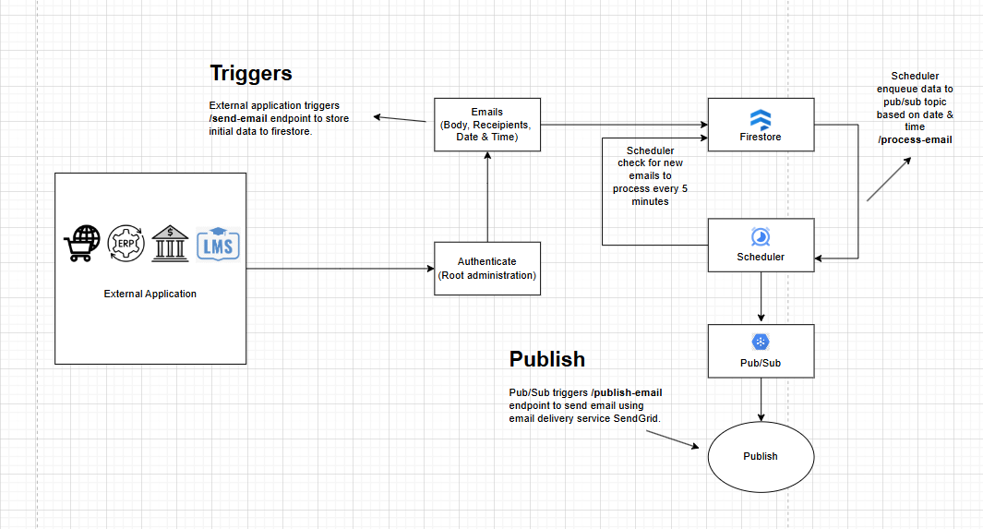
Architecture

Slide 10
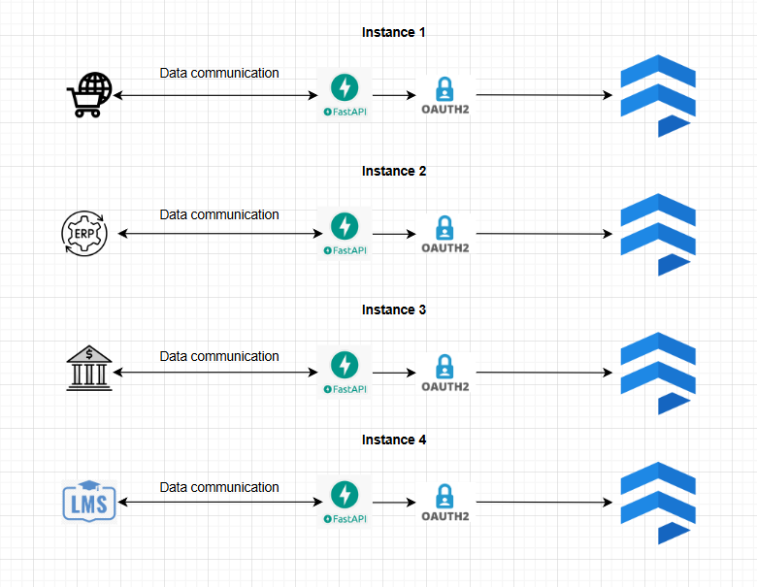
Data Collection

Slide 11
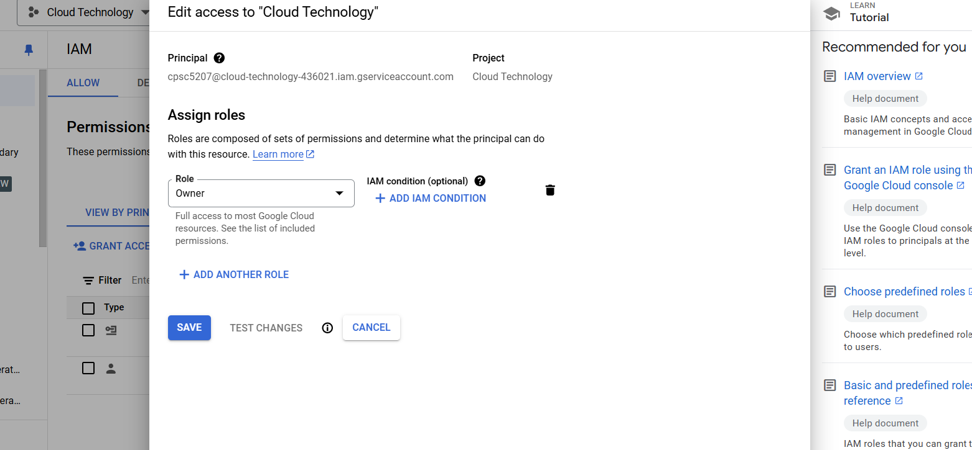
Service Account

Slide 12
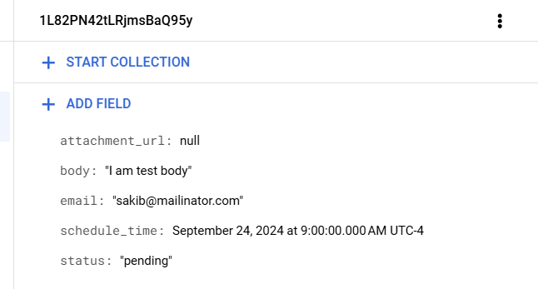
Data Structure

Slide 13
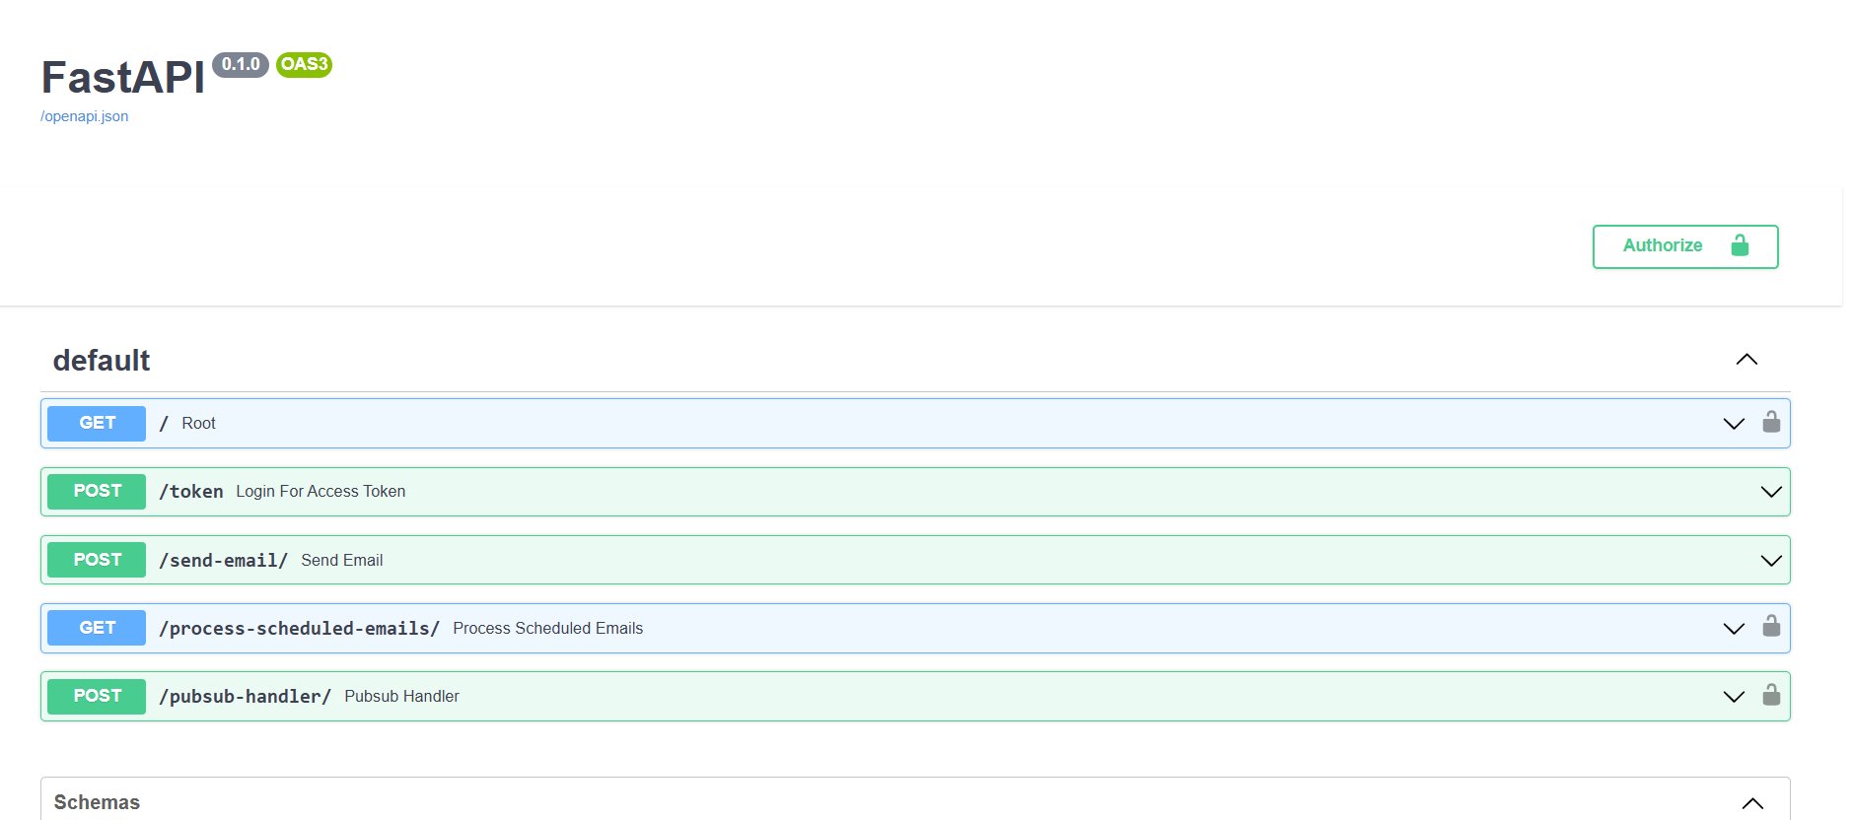
Debugging - Swagger UI

Slide 14
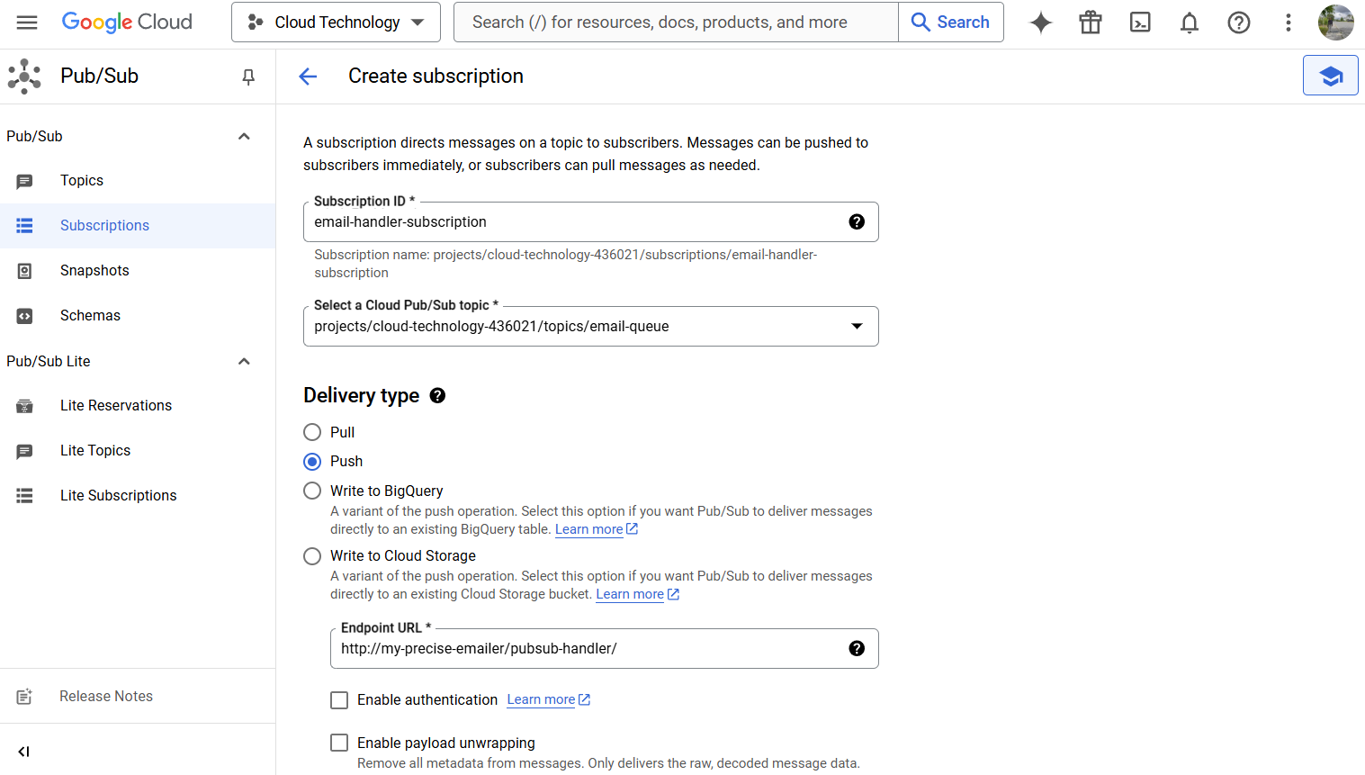
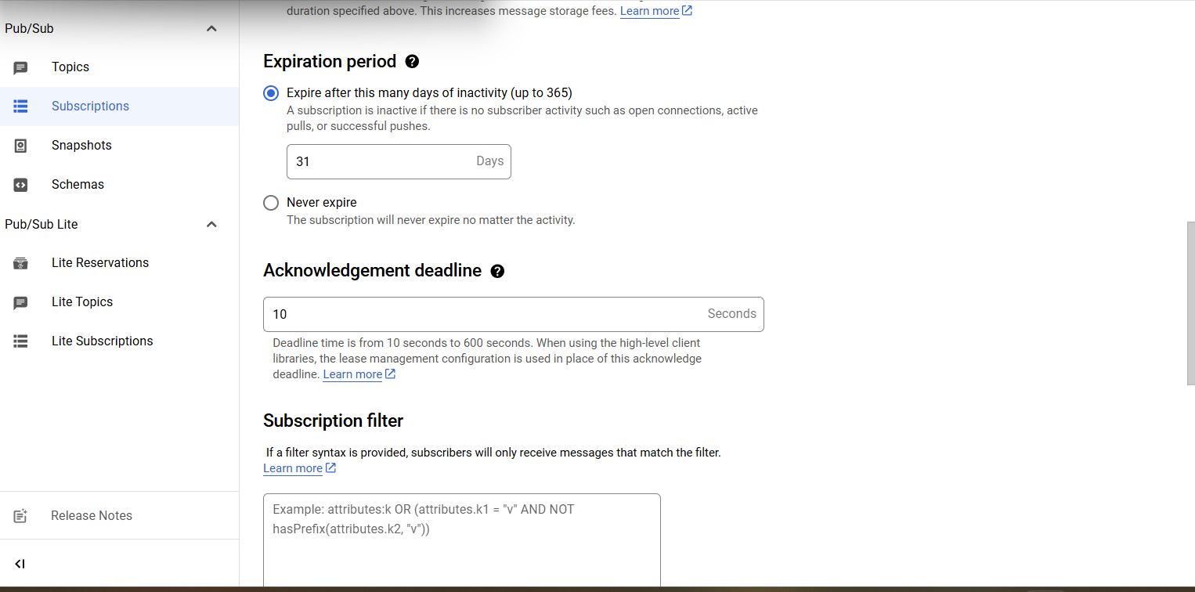
How to setup Cloud
Pub/Sub
Go to Cloud Pub/Sub dashboard (As you already enabled the service)
Create a topic.
Create subscription.
Select subscription type - push
Set endpoint url - https://your-domain/pubsub-handler
Set acknowledgement deadline to 10 seconds (If the response status code is not 200 ok, the pubsub will retry)

Slide 15
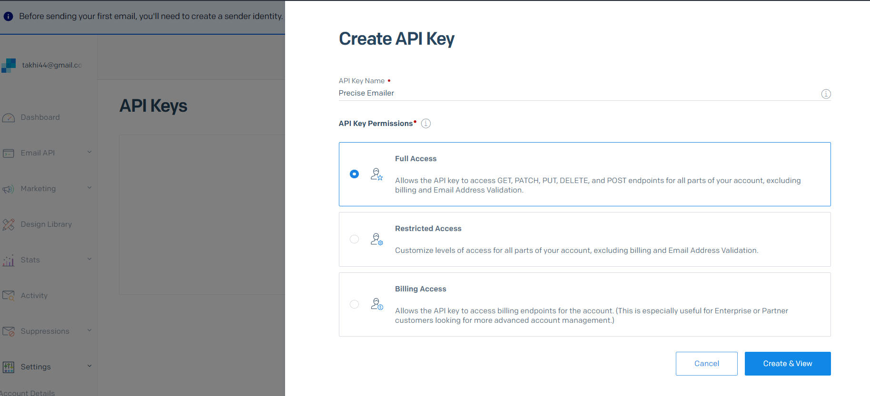
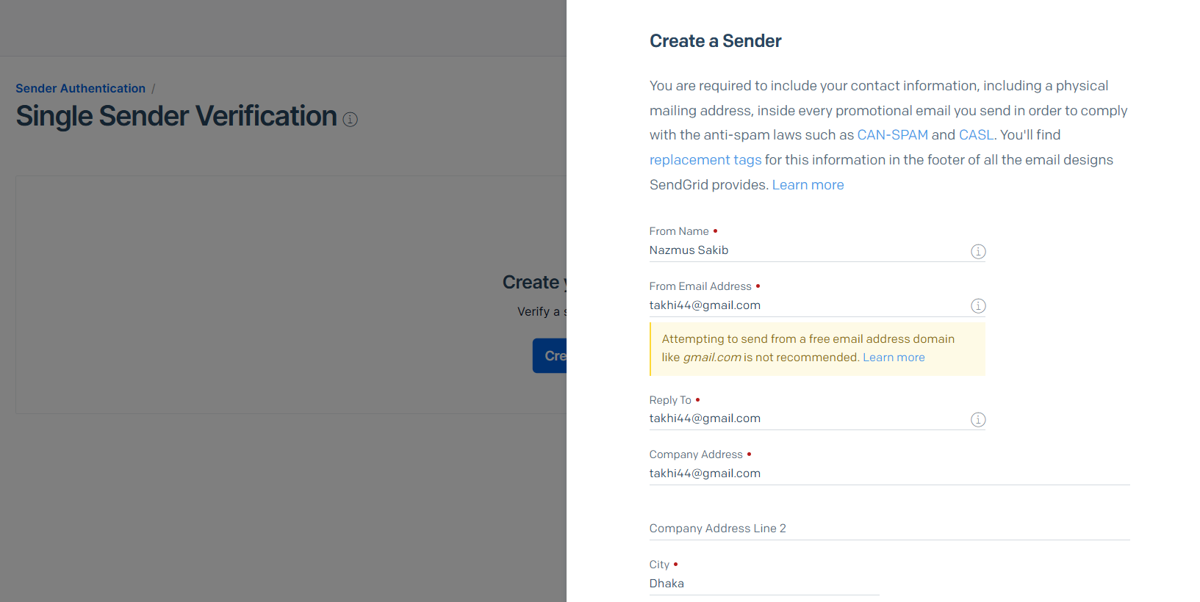
SendGrid
Login to SendGrid
Generate API key through Full Access
Add the saved API key to projects .env file
Go to settings, Sender Verification.
Add Sender to details to verify your sender email.
Add the verified email to projects .env file (Which will be used as from Email to deliver the emails)
Manually trigger the pubsub handler endpoint from swagger ui to test the emails are deliverying or not.

Slide 16

Future Improvements
Advanced Email Analytics
analytics to track email performance, such as open rates, click-through rates, and delivery status.
Enhanced Scheduling Features
Allow users to set recurring schedules (e.g., daily, weekly emails) or send emails at specific time zones

Slide 17
References
https://www.hpe.com/ca/en/what-is/on-premises-vs-cloud.html
http://aws.amazon.com/lambda/pricing/
http://cloud.google.com/functions/pricing
http://aws.amazon.com/sns/pricing/
http://cloud.google.com/pubsub/pricing
http://aws.amazon.com/dynamodb/pricing/
http://cloud.google.com/firestore/pricing
http://aws.amazon.com/eventbridge/pricing/
http://cloud.google.com/scheduler/pricing
http://aws.amazon.com/iam/pricing/
http://cloud.google.com/identity-platform/pricing
http://aws.amazon.com/ses/pricing/
http://sendgrid.com/pricing/

Slide 18
Thank You

